Slide 1
Term Project Iteration 3 Walkthrough

Slide 2
Iteration 3 Components
Initial DBMS Physical ERD
You create an initial DBMS physical ERD, which is tied to a specific relational database vendor and version, with SQL-based constraints and datatypes.
Add Specialization-Generalization
You add in specialization-generalization into your structural database rules and conceptual ERD.

Slide 3
Specialization-Generalization Relationships

Slide 4
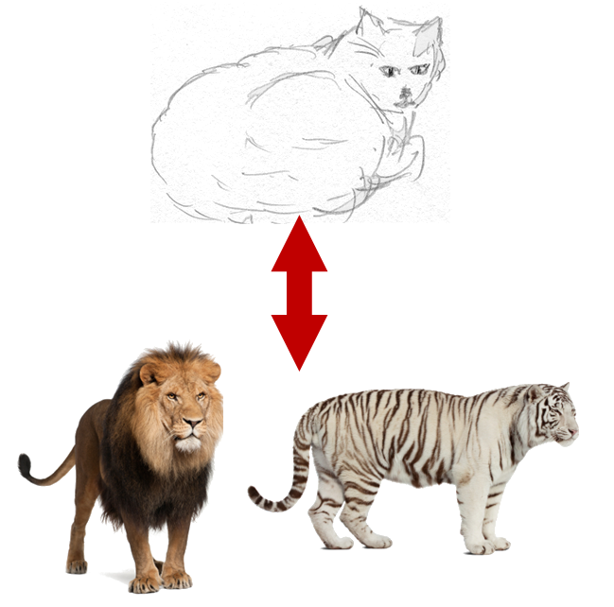
Specialization-Generalization
Notes:
A BOOK is a PRODUCT
BOOK is the subtype, PRODUCT is the supertype
A MAGAZINE is a PRODUCT
A LION is a CAT
Subtype entities “inherit” all of the attributes of the supertype entity

Slide 5
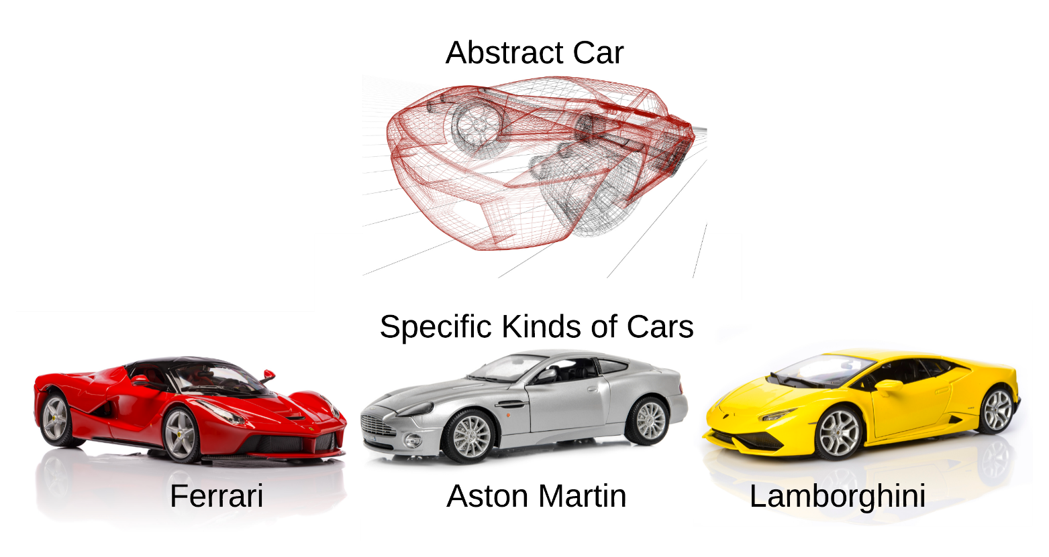
Specialization-Generalization Relationship
Notes:
Another important kind of relationship modeled in ERDs is the specialization-generalization relationship.

Slide 6
Extended ERDs
A conventional ERD allows modeling of associative relationships, informally known as “has a” relationships.
An EERD allows modeling of associative and specialization-generalization relationships, which are informally known as “is a” relationships.
EERDs introduce additional notation to support specialization-generalization relationships.

Slide 7
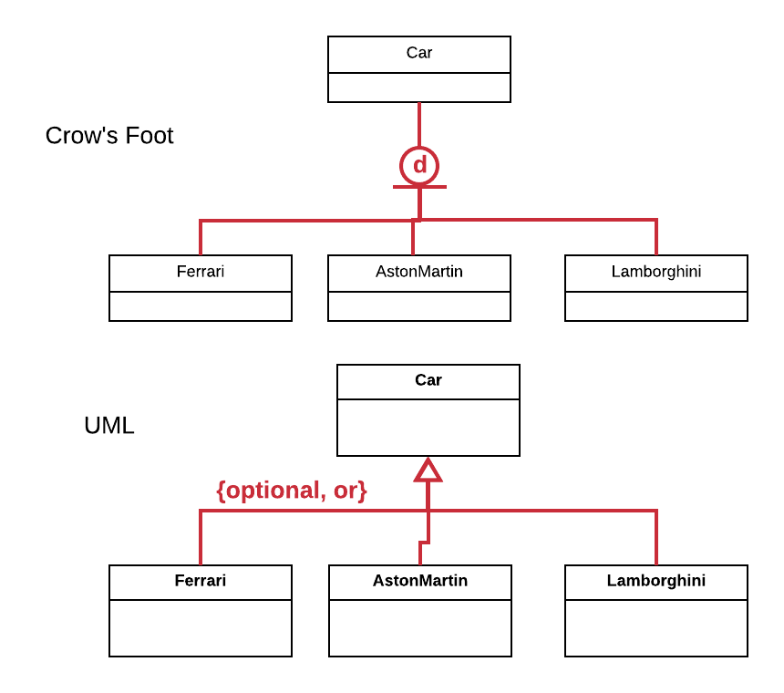
Conceptual Example
Notes:
Such ERDs are called extended ERDs or EERDs.

Slide 8


EERD Symbol Summary
 | Partial | Total
Crow’s Foot Extensions
UML | OPTIONAL | MANDATORY
 | Disjoint | Overlapping
Crow’s Foot Extensions | d | O
UML | OR | AND

Slide 9
Specialization Structural Rules
Structural database rules for specialization-generalization relationships are somewhat simpler.
The supertype name is specified, along with the names of all subtypes, and indicators for disjointness and completeness are given.

Slide 10
Specialization Rule Examples
A pizza is a vegetable pizza, a pepperoni pizza, an anchovy pizza, or none of these.
A writer is right-handed, left-handed, or both of these.
A person is a parent, grandparent, great grandparent, none of these, or all of these.

Slide 11
Specialization Demo

Slide 12
DBMS Physical ERDs

Slide 13
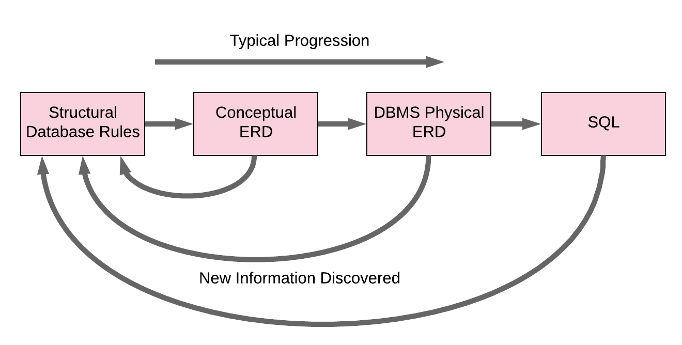
Typical Implementation Progression

Slide 14
Mapping to DBMS Physical
Given that we create the conceptual ERD before creating the DBMS physical ERD, the initial process is of mapping one to another rather than creating from scratch.
The initial mapping contains the entities, relationships, and primary and foreign keys; the attributes are added later.
Creating the initial mapping is quite mechanical in nature, and depends entirely upon the relationship classification existing between each two related entities for associative relationships.

Slide 15

Relationship Classification
There are three relationship classifications – one-to-one, one-to-many, and many-to-many.
Notes:
Each relationship has a participation constraint and plurality constraint from the perspective of both entities, and relationship classification references only the plurality.
There are three relationship classifications – one-to-one, one-to-many, and many-to-many.
Relationship classification does not indicate direction, and is a summary of a relationship with some details left out.

Slide 16
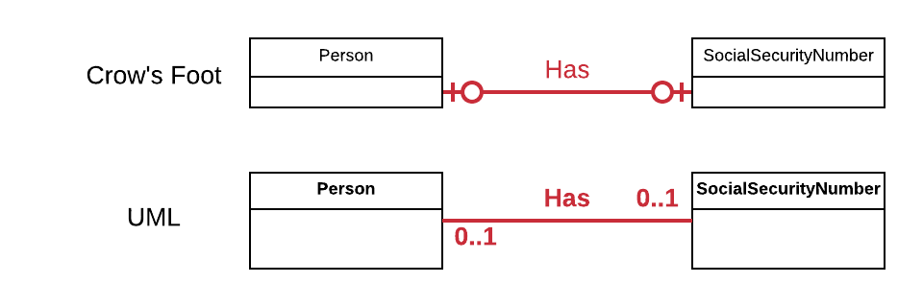
One-to-One Example

Slide 17
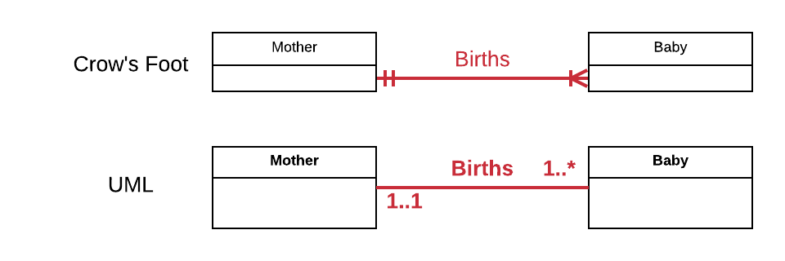
One-to-Many Example

Slide 18
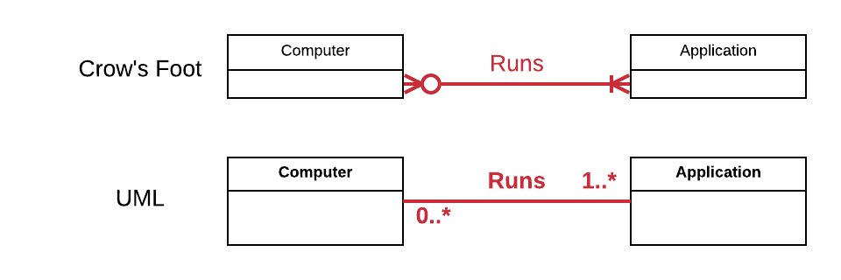
Many-to-Many Example

Slide 19
Mapping Associative Relationships
Since foreign keys are used to enforce relationships in the relational model, the process of mapping relationships mostly deals with which foreign keys to create and where to place them.
The relationship classification of a relationship determines the number and placement of the foreign key(s).
The same classification always maps to the same number and placement of foreign keys.
The entity and relationship names may differ for every relationship, but there are only three ways of placing foreign keys.

Slide 20
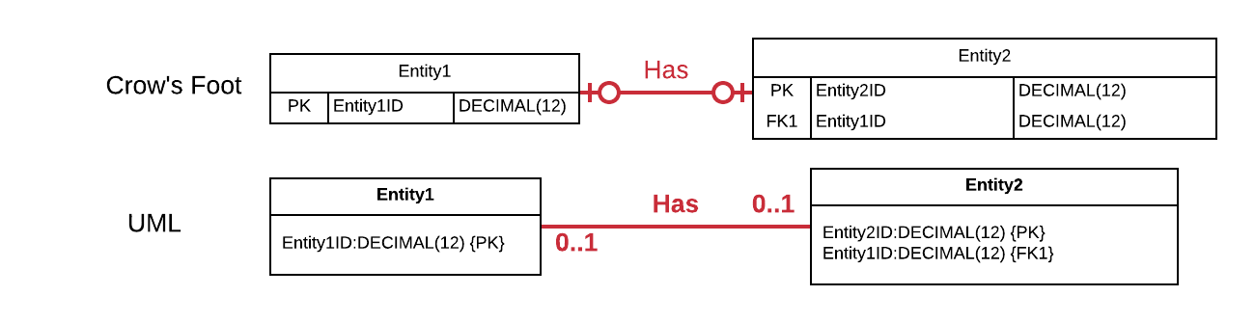
Mapping One-to-One
Notes:
When two entities are related with a 1:1 relationship, the DBMS physical ERD will have a foreign key in either one of the entities to enforce the relationship.
A theoretically pure implementation would have both entities contain foreign keys referencing each other; however, such cyclical references are impractical. If Entity1 references Entity2, and Entity2 references Entity1, then it’s very difficult to insert rows into either table once they are implemented in SQL.
Now you see primary/foreign key indicators, attribute names, and datatypes in the diagram.

Slide 21
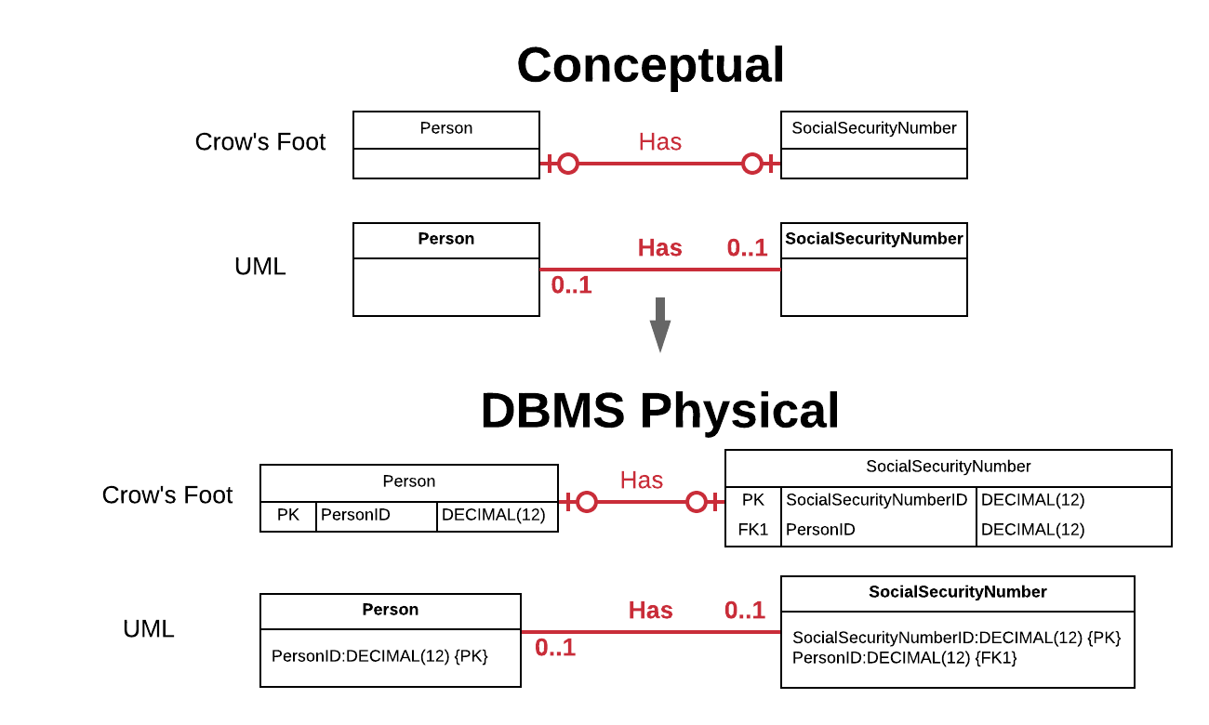
One-to-One Mapping Example

Slide 22

Mapping One-to-Many
Notes:
When two entities are related with a 1:M relationship, the DBMS physical ERD will have a foreign key in the entity that is related at most one of the other entity. That is, the entity that is singular has the foreign key.
Why does it matter where we place the foreign key? The answer lies in one seemingly innocuous property of the relational model: every field contains at most one value.
When we apply that property to foreign keys, then every foreign key contains at most one value. A foreign key cannot contain references to many instances; it contains a reference to at most one instance.
This is why we must place the foreign key in the singular entity.

Slide 23
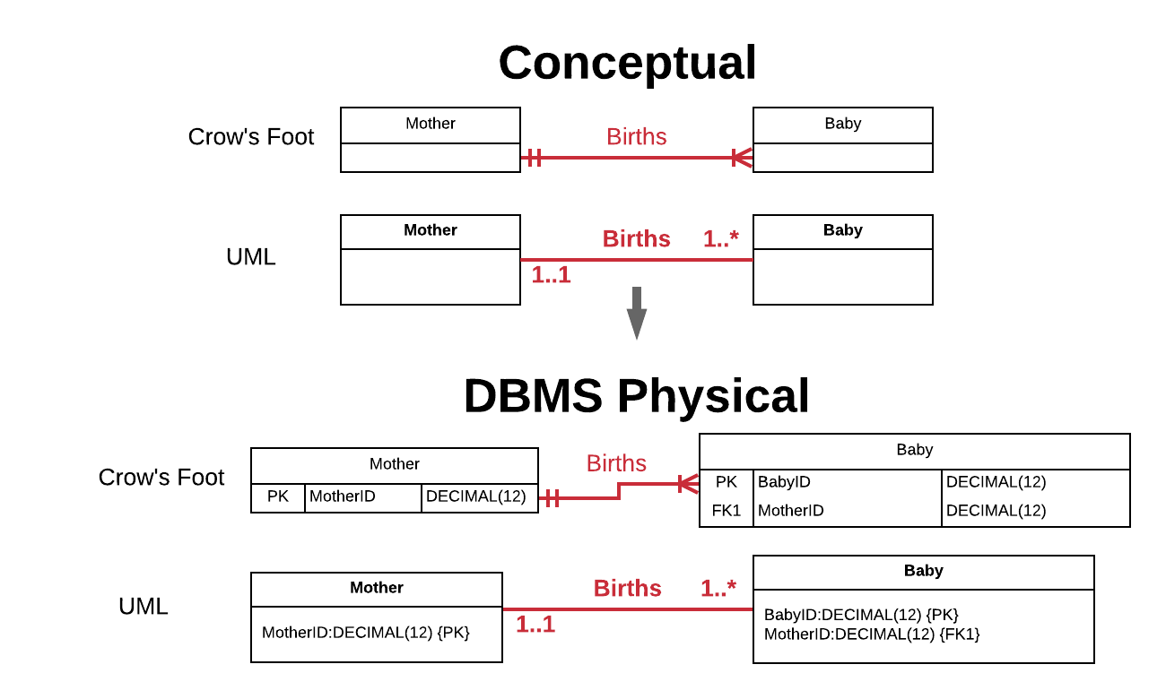
One-to-Many Mapping Example

Slide 24
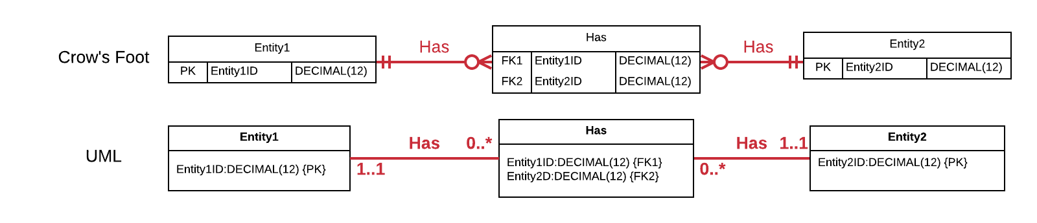
Mapping Many-to-Many
Notes:
When two entities are related with a M:N relationship, the relationship itself must be reified into an entity.
The new entity is termed a bridging or linking entity, because it exists just to bridge or link the other two entities together.
If each instance of Entity1 can reference multiple instances, and each instance of Entity2 can reference many instances, then we cannot place the foreign key in either Entity1 or Entity2. Foreign keys cannot reference multiple instances.

Slide 25
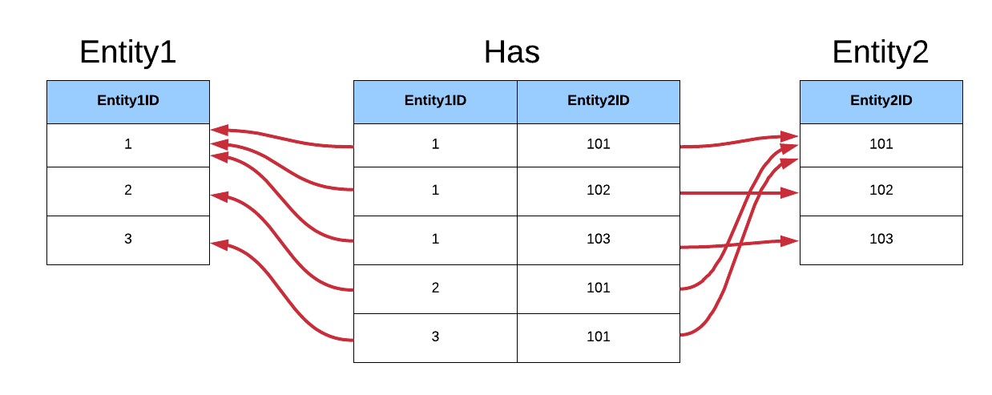
Many-to-Many References
Notes:
Entity1 row 1 is related to all three rows in Entity2.

Slide 26
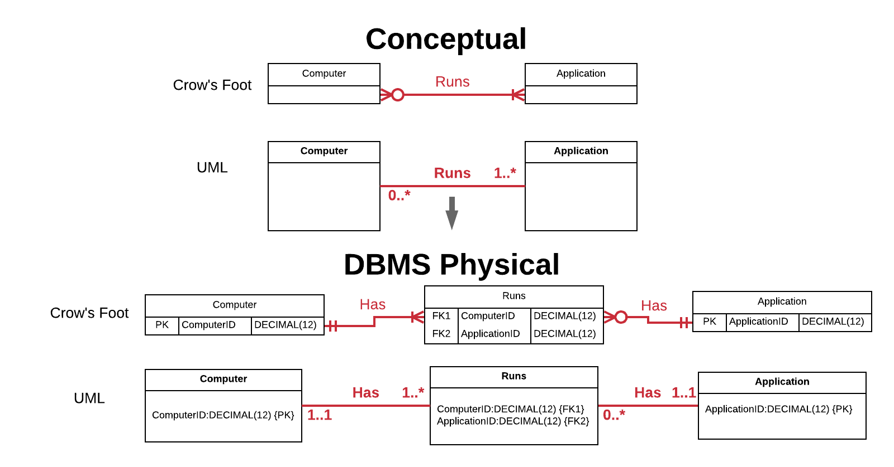
Many-to-Many Mapping Example

Slide 27
Relationship Strength
Associative relationships are either identifying, also known as “strong”, or non-identifying, also known as “weak”.
An identifying relationship is one where the entity’s primary key is composed of a foreign key to another entity, either in part or in full.
A non-identifying or “weak” relationship is any other kind of relationship, that is, any relationship that does not involve an entity’s primary key referencing another entity through a foreign key.
identifying relationships can be designated with a solid relationship line, while non-identifying relationship can be identified with a dashed line (Crow’s Foot Only).

Slide 28
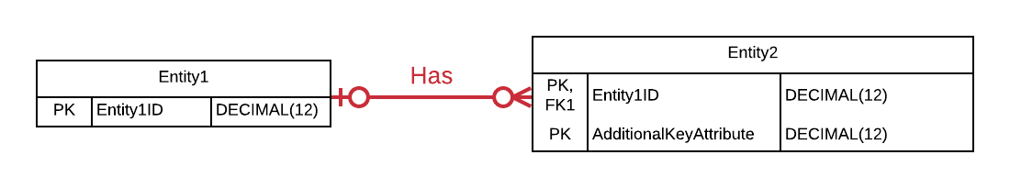
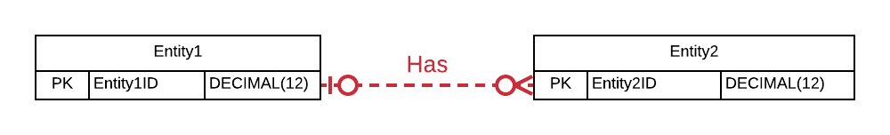
Relationship Strength ERDs
Identifying
Non-Identifying
Use of solid and dashed lines is relegated to academic exercises rather than being an important modeling technique.

Slide 29
Mapping Specialization-Generalization
Specialization-generalization relationships are not surprisingly mapped differently than associative relationships.
The mechanics of mapping specialization-generalization relationships are much simpler.
There is only rule for mapping specialization-generalization relationships: the supertype contains a primary key, and all subtypes have the same primary key as the supertype through use of a foreign key constraint.

Slide 30
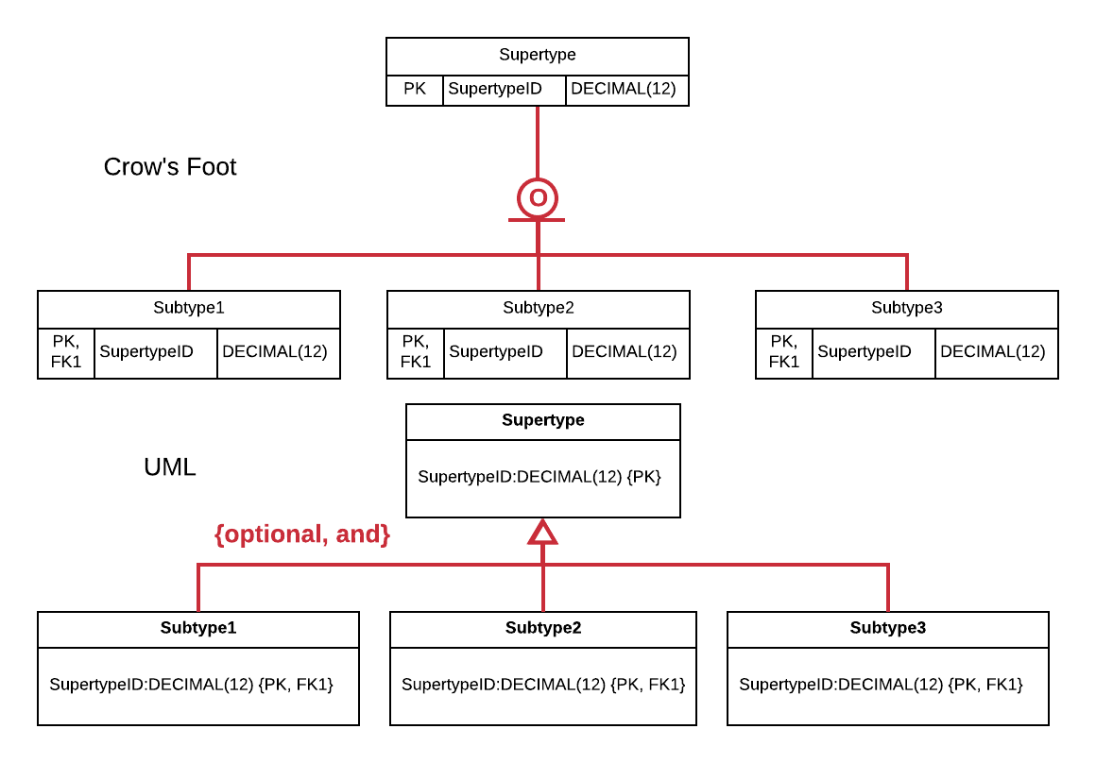
General Specialization ERD
Notes:
Most important, take a look at the primary keys of the entities in this example. The supertype has a primary key named “SupertypeID”, as does all of the subtypes.
You will also notice that the primary keys of the subtypes are also foreign keys.
The completeness and disjointness constraints do not affect the mapping of specialization-generalization relationships.

Slide 31
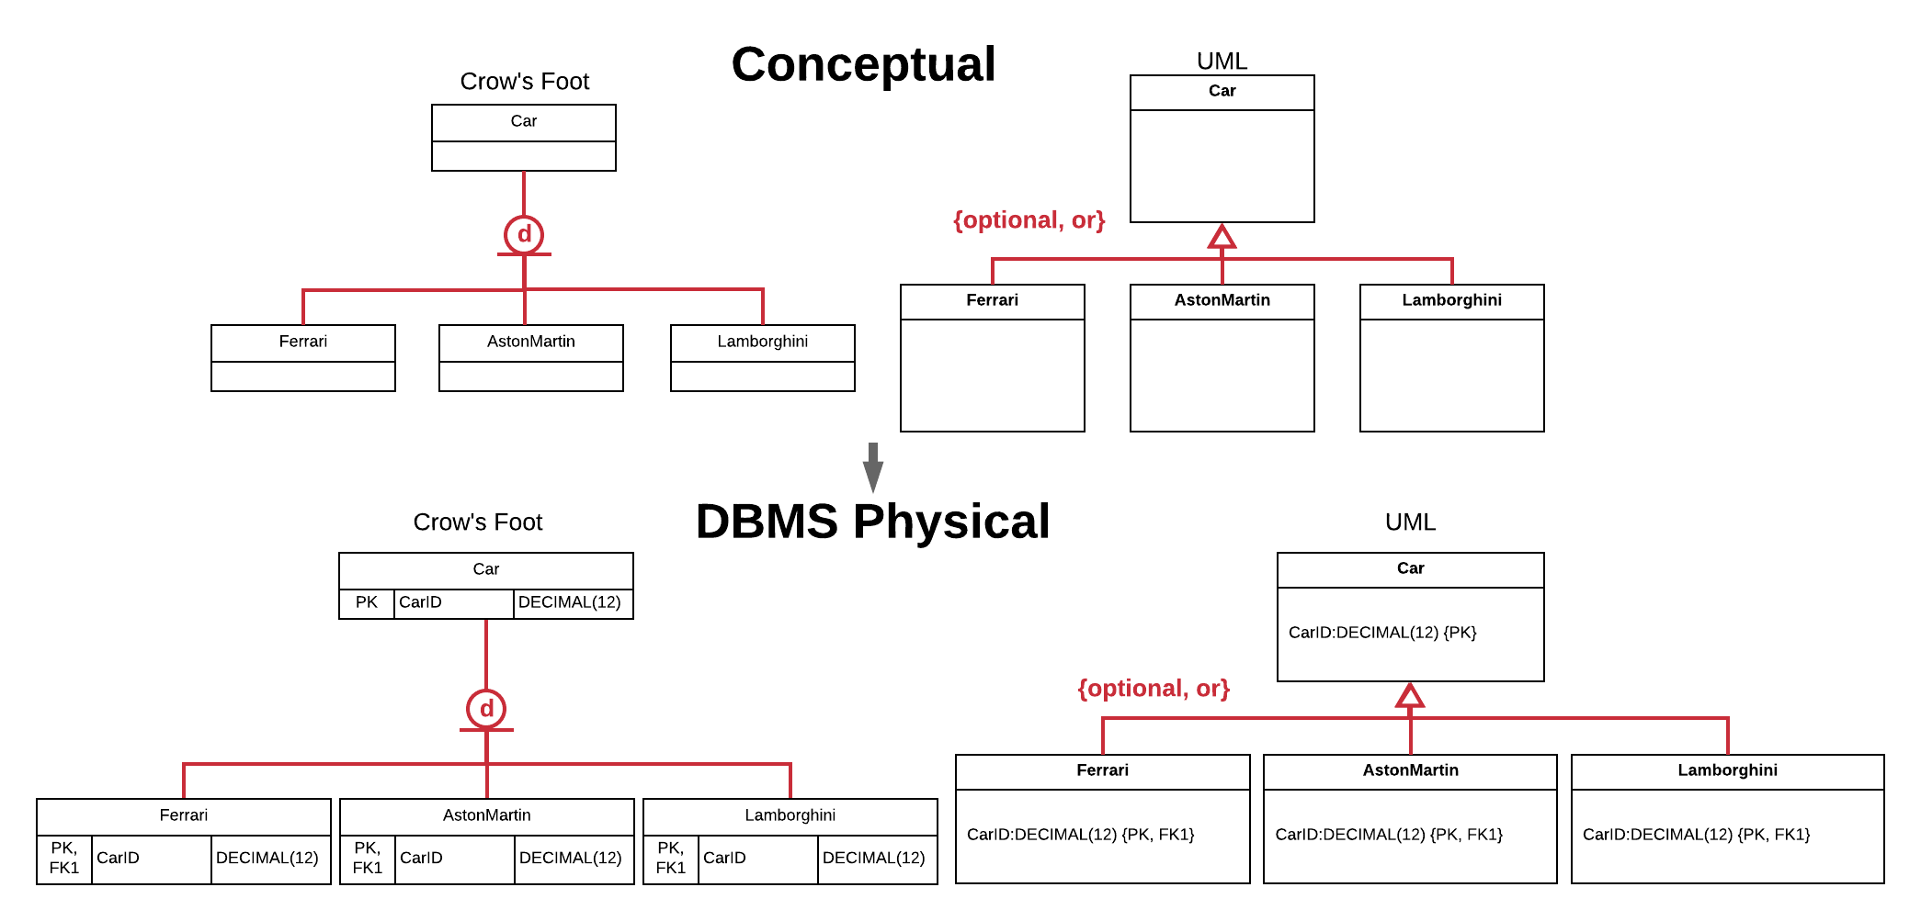
Mapping Specialization Example

Slide 32
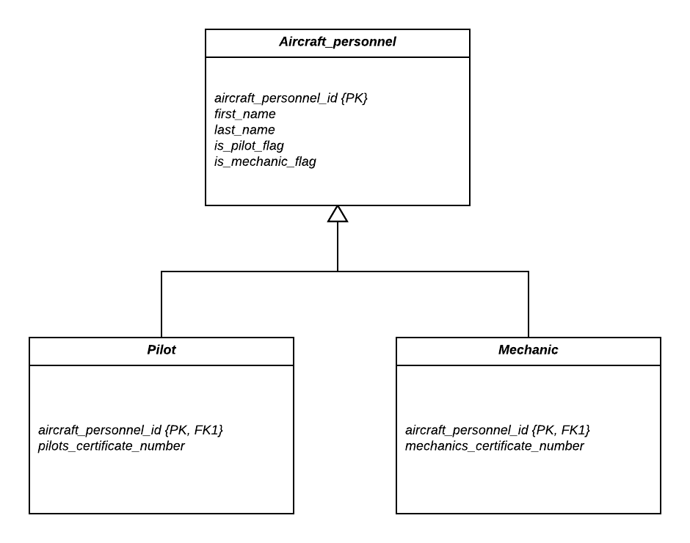
Overlapping Example

Slide 33
Subtype Discriminator
In both Crow’s Foot notation and in a modified UML class diagram, subtype discriminator’s can be placed to the right of the relationship line (though again, this is academic but not typically done).
Subtype discriminators are typically only a single attribute if the relationship is disjoint.
If the relationship is overlapping, the subtype discriminator makes use of flags.

Slide 34
Mapping Demo

Slide 35
Specialization-Generalization Evaluation
Aspect | What is Measured | Achieving Excellence
Structure of Specialization-Generalization Rule(s) (5%) | This measures how well-formed and unambiguous the specialization-generalization structural database rules are. An excellent rule clearly defines the entities, relationships, and constraints, and identifies a supertype and at least two subtypes. | Entirely well-formed Entirely unambiguous
Specialization-Generalization Sufficiency (10%) | This measures how essential the specialization-generalization entities and relationships are to your database. Being essential means that the supertype and subtype entities and the relationship support very important aspects of the database. | Entirely essential
Accuracy of Specialization-Generalization Relationship Constraints (10%) | This measures how accurate the specialization-generalization completeness and disjointess constraints are given the needs of the database. | Entirely accurate
Specialization-Generalization ERD Representation (10%) | This measures how well the supertype entities, subtype entities, and relationships reflect what is defined in the specialization-generalization structural database rules, and the correctness of the diagrammatic notation. | Entirely reflects rules Entirely correct diagrammatic notation

Slide 36
DBMS Physical Evaluation
What is Measured | Achieving Excellence
This measures how correctly the DBMS physical ERD maps all entities, relationships, and relationship constraints. An excellent mapping is enforced properly with primary and foreign keys. | Entirely correct

Slide 37
Overall Evaluation
Aspect | What is Measured | Achieving Excellence
Overall Presentation (10%) | This measures how well the choices for the structural database rules, entities, relationships, constraints, the ERD, and other design aspects are supported with explanations, in addition to the documentation organization and presentation. | Excellent support Well organized and presented
Prior Work Soundness (15%) | This measures how well any issues from prior iterations have been improved in order to provide a frame of reference for this iteration. | Completely improved or No improvement necessary

Slide 38

End

